Slide 1

Artificial Intelligence In Medicine
By: Alec Meyer

Slide 2
“We can only see a short distance ahead, but we can see plenty there that needs to be done.”
– Alan Turing, ‘Computing Machinery and Intelligence’

Slide 3
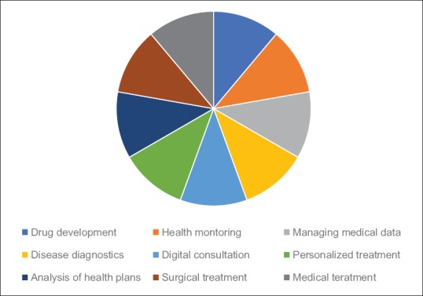
What is Artificial Intelligence in medicine?

Slide 4
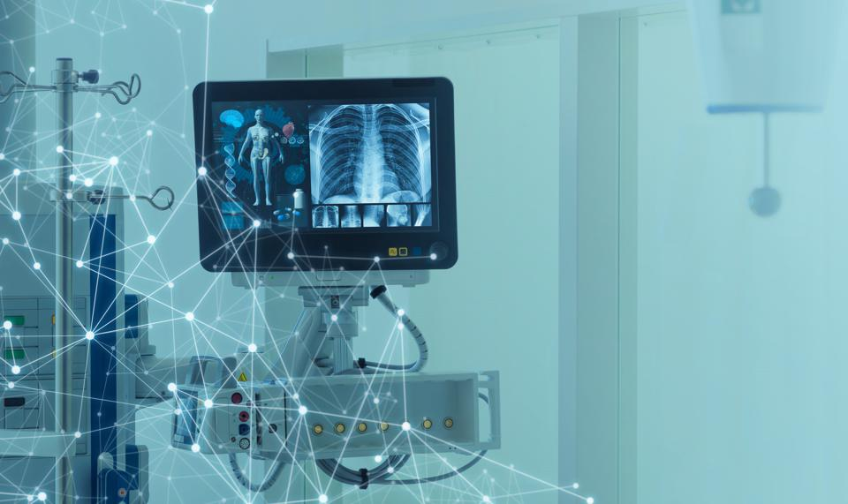
Accuracy of diagnoses
Flowchart vs.
Database
AI: 82%
Doctor Avg: 72%
Tuberculosis

Slide 5

Patient Wait times
Wait times:
-Low-risk patients
-High-risk patients
Social Anxiety

Slide 6
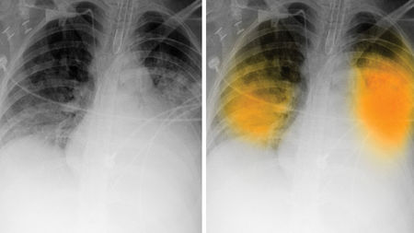
Artificial intelligence implementation
Radiology
- False positives

Slide 7

Final Thoughts

Slide 8
“A very large part of space-time” must be investigated, if reliable results are to be obtained.”
–Alan Turing

Slide 9
Work cited
Sparrow, Robert, and Joshua Hatherley. “High Hopes for ‘Deep Medicine’? AI, Economics, and the Future of Care.” Hastings Center Report, vol. 50, no. 1, Jan. 2020, pp. 14–17. EBSCOhost, doi:10.1002/hast.1079.
Nadin, Mihai. “Aiming AI at a Moving Target: Health (or Disease).” AI & Society, vol. 35, no. 4, Dec. 2020, pp. 841–849. EBSCOhost, doi:10.1007/s00146-020-00943-x.
Amisha et al. “Overview of artificial intelligence in medicine.” Journal of family medicine and primary care vol. 8,7 (2019): 2328-2331. doi:10.4103/jfmpc.jfmpc_440_19
Sagar Kulkarni, Nuran Seneviratne, Mirza Shaheer Baig, Ameer Hamid Ahmed Khan, Artificial Intelligence in Medicine: Where Are We Now?, Academic Radiology, Volume 27, Issue 1, 2020, Pages 62-70, ISSN 1076-6332, https://doi.org/10.1016/j.acra.2019.10.001
Jonah Comstock. “Artificial intelligence passes recreation of UK's GP exam and performs against doctors in simulated tests.” Healthcare IT News, https://www.iqpc.com/events-digitalhealthcareonline/downloads/artificial-intelligence-passes-recreation-of-uks-gp-exam-and-performs-against-doctors-in-simulated-tests

